Slide 1


Slide 2
Choose
ReactJS + AXIOS
Angular + Observables

Slide 3

Notes:
http://coenraets.org/present/react/#3
http://slides.com/alexanderfarennikov/react-js-fundamentals/fullscreen#/20
https://scotch.io/tutorials/learning-react-getting-started-and-concepts

Slide 4
What to install?
Install git
Install node
Install yarn

Slide 5
Github workshop!
git clone https://github.com/petereijgermans11/workshop-reactjs-angular.git
cd ./react-app
yarn start
# Happy hacking ! ;-)

Slide 6
Syntax Component
Class Welcome {
}
IN HTML:
<Welcome />
Notes:
Component = main building block React.
COMPONENT
Here, Welcome is a React component class. Always start component names with a capital letter.
A component takes in parameters, called props, and returns a (hierarchy of) views to display via the render method.
JSX:
The view: is a combination of HTML and Javascript!!! Called JSX
You can embed any JavaScript expression in JSX by wrapping it in curly braces.
----------------
Conceptually, components are like JavaScript functions. They accept arbitrary inputs (called "props") and return React elements describing what should appear on the screen.
Always start component names with a capital letter.
For example, <div /> represents a DOM tag, but <Welcome /> represents a component and requires Welcome to be in scope.

Slide 7
Syntax Component
Class Welcome extends React.Component{
render( ) {
}
}
IN HTML:
<Welcome />
Notes:
Component = main building block React.
COMPONENT
Here, Welcome is a React component class. Always start component names with a capital letter.
A component takes in parameters, called props, and returns a (hierarchy of) views to display via the render method.
JSX:
The view: is a combination of HTML and Javascript!!! Called JSX
You can embed any JavaScript expression in JSX by wrapping it in curly braces.
----------------
Conceptually, components are like JavaScript functions. They accept arbitrary inputs (called "props") and return React elements describing what should appear on the screen.
Always start component names with a capital letter.
For example, <div /> represents a DOM tag, but <Welcome /> represents a component and requires Welcome to be in scope.

Slide 8
Syntax Component
Class Welcome extends React.Component{
render( ) {
return <div>Hello { this.props.name } </div>; → JSX
}
}
IN HTML:
<Welcome name="Sara" />
Hello Sara
Notes:
Component = main building block React.
COMPONENT
Here, Welcome is a React component class. Always start component names with a capital letter.
A component takes in parameters, called props, and returns a (hierarchy of) views to display via the render method.
JSX:
The view: is a combination of HTML and Javascript!!! Called JSX
You can embed any JavaScript expression in JSX by wrapping it in curly braces.
----------------
Conceptually, components are like JavaScript functions. They accept arbitrary inputs (called "props") and return React elements describing what should appear on the screen.
Always start component names with a capital letter.
For example, <div /> represents a DOM tag, but <Welcome /> represents a component and requires Welcome to be in scope.

Slide 9
Component: class
2 types of state:
this.props
Get properties from parent component
this.state
Local state within components

Slide 10
export class Welcome extends React.Component {
render( ) {
return <h1>Hello, { this.props.name }</h1>;
}
}
class App extends React.Component {
render( ) {
return (
<div>
<Welcome name="Sarah" />
<Welcome name=”Ellis" />
<Welcome name=”Maria" />
</div>
);
}
}
ReactDOM.render(
<App />, document.getElementById('root')
);
Notes:
Export?

Slide 11
this.props
Never changes props!
This is the responsibility for the parent

Slide 12
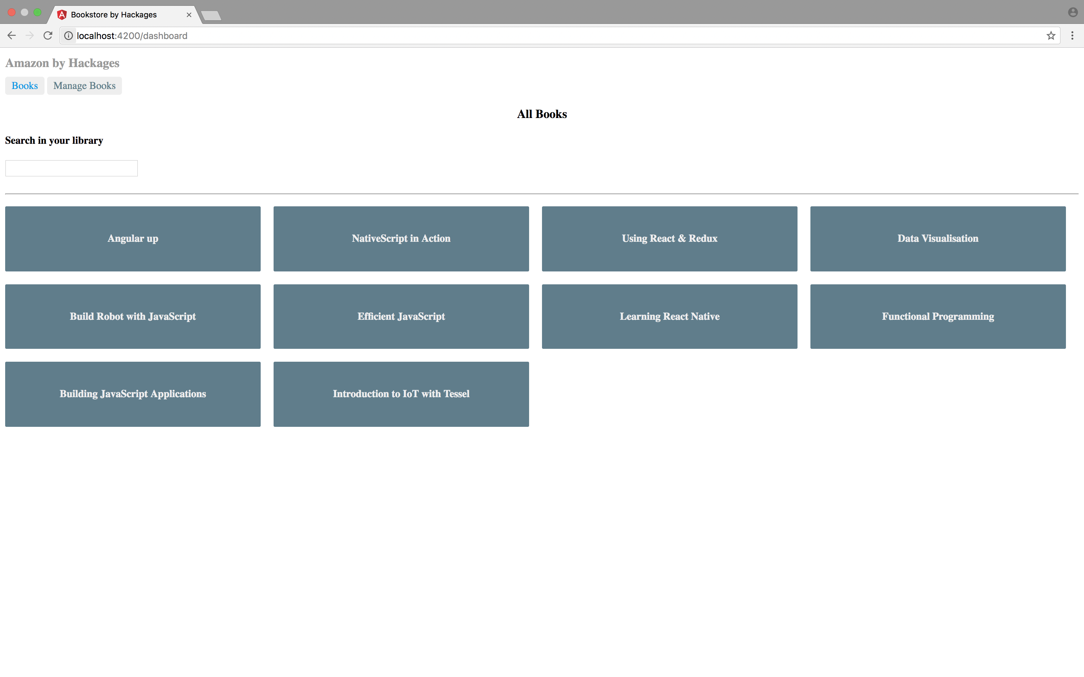
BookSearch and DashBoard

Slide 13
Component based
Index.html
props
AppComponent
props
props
props
BookSearchComponent
DashBoardComponent
BooksComponent
props
props
BookDetalsComponent

Slide 14
Component based
AppComponent
BookSearchComponent
DasboardComponent

Slide 15
Async Programming
Use AXIOS !
Notes:
Voorbeeld Whatsapp. Async communcatie met messaging.
Why Axios?

Slide 16
Axios Syntax
axios.get( ‘http://url…’ )
.then(response => console.log(response))
.catch(error => console.log(error))

Slide 17
DashBoardComponent
export class Dashboard extends React.Component {
constructor(props) {
super(props);
this.state = {
books: [‘book1’,’book2’]
}
}
componentDidMount(){
// You should fetch de books from http://localhost:5000/books
// and store them in your state
}
render() {
return (
<div>
<h3>All Books</h3>
<BookSearch />
{ this.state.books.map(book => (
<h4>{book}</h4>
)) }
</div>
);
}
}
Notes:
Use ES6 arrow functions
An arrow function expression has a shorter syntax than a function expression and does not bind its own this.
You can program in an object oriented OR functional way with Arrow functions.

Slide 18
DashBoardComponent
export class Dashboard extends React.Component {
constructor(props) {
super(props);
this.state = {
books: [ ]
}
}
componentDidMount() {
axios.get("http://localhost:5000/books")
.then((response) => {
this.setState({
books: response.data
})
});
}
render() {
return (
<div>
<h3>All Books</h3>
<BookSearch />
{ this.state.books.map(book => (
<h4>{book.title}</h4>
)) }
</div>
);
}
}
Notes:
Zie data.json voor de test data!
Use ES6 arrow functions!

Slide 19
Axios Syntax
axios.get("http://localhost:5000/books)
.then((response) => {
this.setState({
books: response.data
})
});
Notes:
AXIOS? = Op async wijze ophalen van data
Use ES6 arrow functions? Je kan op een functionele manier programmeren.

Slide 20
BookSearchComponent
export class BookSearch extends React.Component {
constructor(props) {
super(props);
this.state = {
books: [ ],
}
}
search = (event) => {
axios.get("http://localhost:5000/books/?q=" + event.target.value)
.then((response) => {
this.setState({
books: response.data
})
});
};
Notes:
Set State!
Use AXIOS: Promise based HTTP client for node.js
Use ES6 arrow functions
An arrow function expression has a shorter syntax than a function expression and does not bind its own this.
You can program in an object oriented OR functional way with Arrow functions.

Slide 21
Axios Syntax
axios.get("http://localhost:5000/books/?q=" + searchTerm)
.then((response) => {
this.setState({
books: response.data
})
});
Notes:
AXIOS? = Op async wijze ophalen van data
Use ES6 arrow functions? Je kan op een functionele manier programmeren.

Slide 22
this.setState()
Do not! Change state with:
this.state = newState
Use:
this.setState( { … } )
Notes:
Otherwise react will not re-render, and possibly overwrite your state.

Slide 23
Template literals
let url = 'http://localhost:3000/api/messages/' + id
let url = `http://localhost:3000/api/messages/${id}`

Slide 24
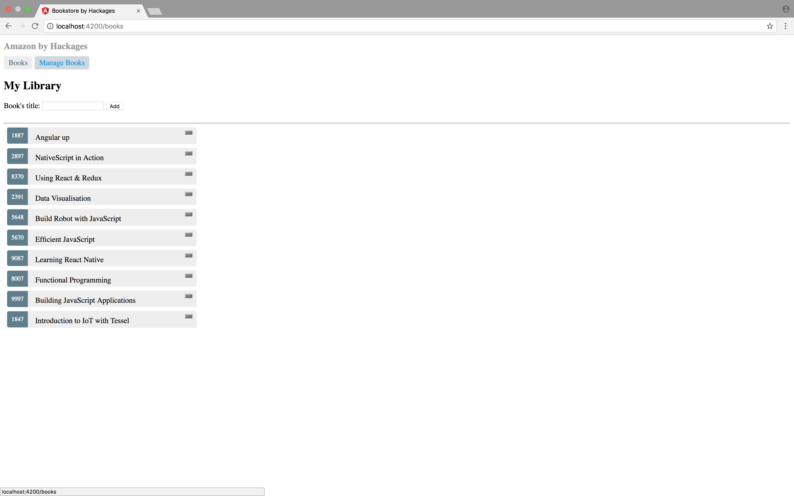
BooksComponent

Slide 25
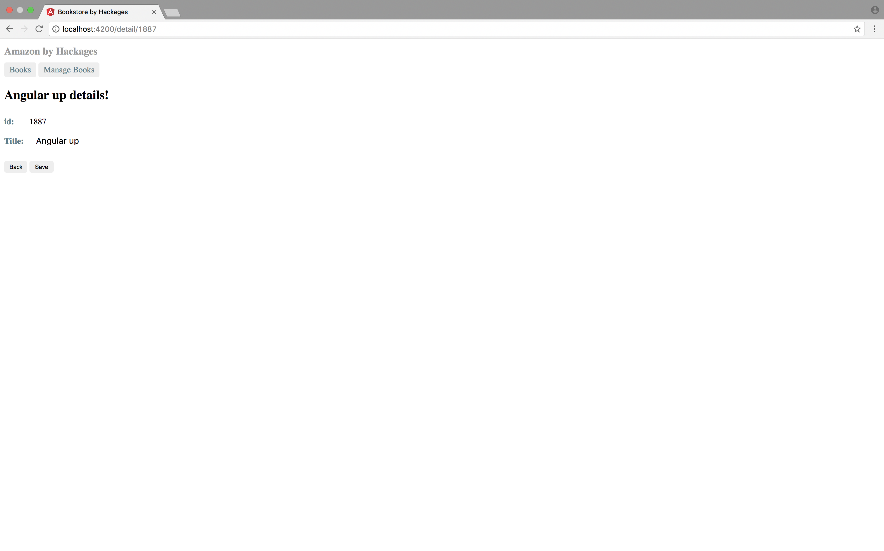
BookDetailComponent

Slide 26
BookDetailComponent
export class BookDetail extends React.Component {
constructor(props) {}
componentDidMount(){
this.fetchBook(this.props.match.params.id );
}
}{
----
App.js
<Route path="/detail/:id" component={ BookDetail } />
Notes:
componentDidMount(){
this.fetchBook(this.props.match.params.id); →
}
https://medium.com/@pshrmn/a-simple-react-router-v4-tutorial-7f23ff27adf
The :number part of the path /book/:number means that the part of the pathname that comes after /book/ will be captured and stored as match.params.number. For example, the pathname /book/6 will generate a params object :
{ number: '6' } // note that the captured value is a string

Slide 27
Github workshop!
git clone https://github.com/petereijgermans11/workshop-reactjs-angular.git
cd ./react-app
yarn start
# Happy hacking ! ;-)

Slide 28
Component: lifecycles
Mounting
Updating
Unmounting
Notes:
https://facebook.github.io/react/docs/react-component.html

Slide 29
Component: lifecycles
Mounting:
constructor()
componentWillMount()
render()
componentDidMount()
Notes:
https://facebook.github.io/react/docs/react-component.html

Slide 30
Component: lifecycles
Updating:
componentWillReceiveProps()
shouldComponentUpdate()
componentWillUpdate()
render()
componentDidUpdate()
Notes:
https://facebook.github.io/react/docs/react-component.html

Slide 31
Component: lifecycles
Unmounting:
componentWillUnmount()
Notes:
https://facebook.github.io/react/docs/react-component.html

Slide 32
Additional information
https://facebook.github.io/react/docs/hello-world.html
https://github.com/airbnb/javascript/tree/master/react

